Slide 1
Crowd Funding Website
A blockchainbased web3 platform.

Slide 2
Project Members
Mohammad Enan Al Harun Sahan
Md. Asadujjaman Noor
Sheikh Nafez Sadnan
Reg: 20101095
Reg: 20101101
Reg: 20101106

Slide 3
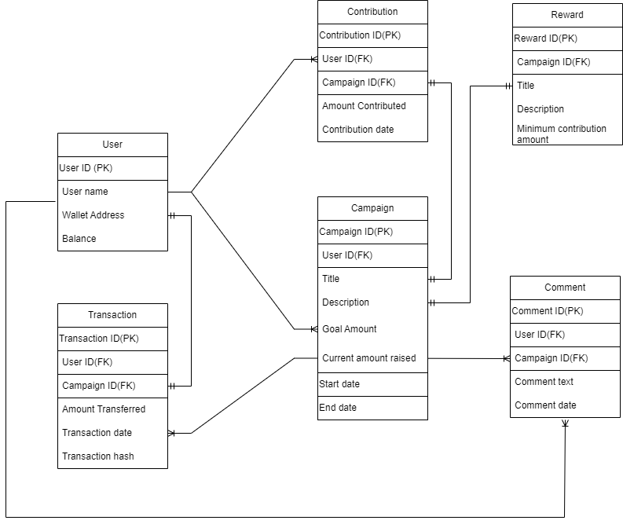
ER Diagram

Slide 4
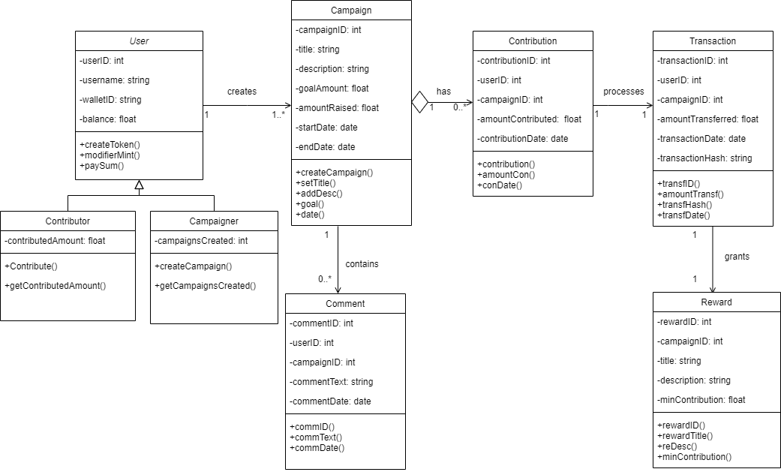
Class Diagram

Slide 5

THANKS!
Do you have any questions?
enanalharun@gmail.com
nafez.sadnan95@gmail.com
asadujjaman1122@gmail.com

